Slide 1
Boolean Algebra & Logic Gates

Slide 2
Fundamental Concepts of Boolean Algebra
Use of Binary Digit
Boolean equations can have either of two possible values, 0 and 1
Logical Addition
Symbol ‘+’, also known as ‘OR’ operator, used for logical addition. Follows law of binary addition
Logical Multiplication
Symbol ‘.’, also known as ‘AND’ operator, used for logical multiplication. Follows law of binary multiplication
Complementation
Symbol ‘-’, also known as ‘NOT’ operator, used for complementation. Follows law of binary compliment

Slide 3
Operator precedence
Each operator has a precedence level -Higher the operator’s precedence level, earlier it is evaluated
Expression is scanned from left to right
First, expressions enclosed within parentheses are evaluated
Then, all complement (NOT) operations are performed
Then, all ‘⋅’ (AND) operations are performed
Finally, all ‘+’ (OR) operations are performed

Slide 4
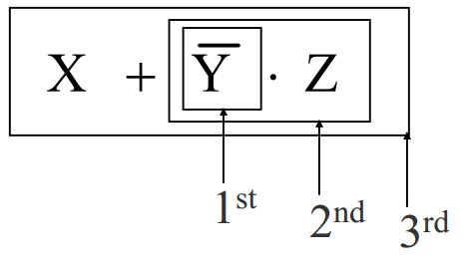

Slide 5
Boolean Functions
A Boolean function is an expression formed with:
Binary variables
Operators (OR, AND, and NOT)
Parentheses, and equal sign
The value of a Boolean function can be either 0 or 1
A Boolean function may be represented as:
An algebraic expression, or
A truth table

Slide 6
W = X +Y ·Z
Variable W is a function of X, Y, and Z, can also written as W = f (X, Y, Z)
The RHS of the equation is called an expression
The symbols X, Y, Z are the literals of the function
For a given Boolean function, there may be more than one algebraic expressions

Slide 7
Logic Gates
Logic gates are electronic circuits that operate on one or more input signals to produce standard output signal
Are the building blocks of all the circuits in a computer
Some of the most basic and useful logic gates are AND, OR, NOT, NAND and NOR gates

Slide 8
AND Gate
Physical realization of logical multiplication (AND) operation
Generates an output signal of 1 only if all input signals are also 1

Slide 9
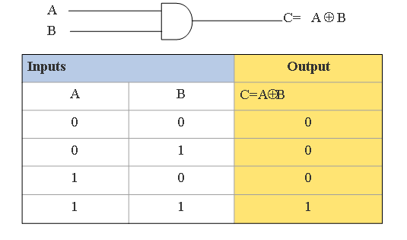

Slide 10
OR Gate
Physical realization of logical addition (OR) operation
Generates an output signal of 1 if at least one of the input signals is also 1

Slide 11
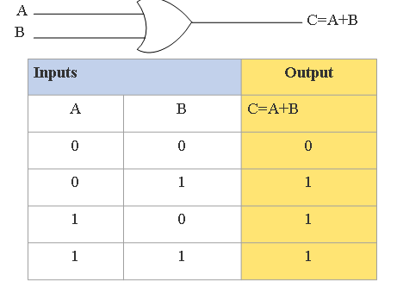

Slide 12
NOT Gate
Physical realization of complementation operation
Generates an output signal, which is the reverse of the input signal

Slide 13
